Slide 1
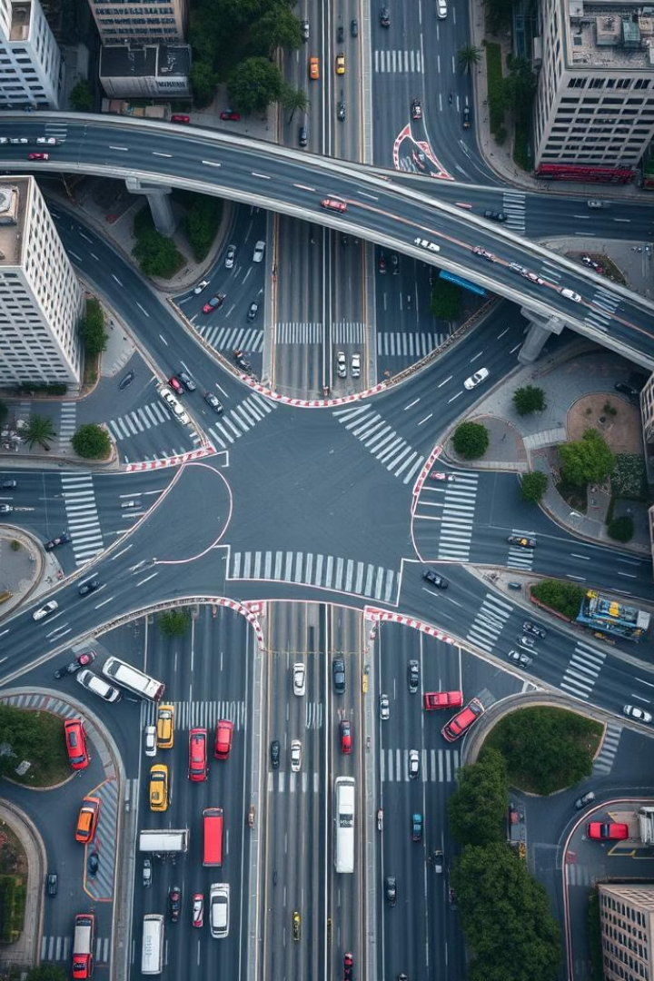
Dynamic Route Rationalization
Dynamic route rationalization is a strategic approach to optimizing transportation logistics in real-time, leveraging data-driven insights to adapt to changing conditions and improve operational efficiency.
-By Hackelites

Slide 2
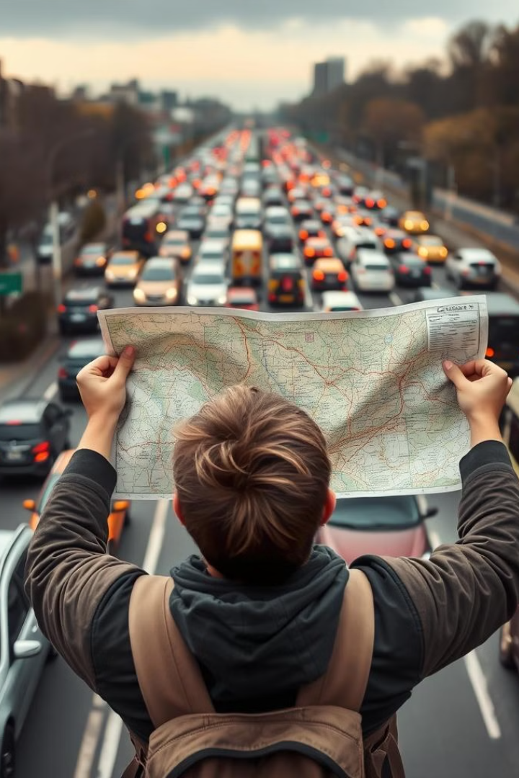
Challenges of Traditional Route Planning
1
Inflexibility
2
Suboptimal Efficiency
Static route planning cannot adapt to unpredictable factors like traffic, weather, or road closures.
Traditional methods often lead to longer travel times, higher fuel consumption, and increased operational costs.
3
Limited Visibility
Lack of real-time data integration makes it difficult to make informed decisions and respond to changes in a timely manner.

Slide 3
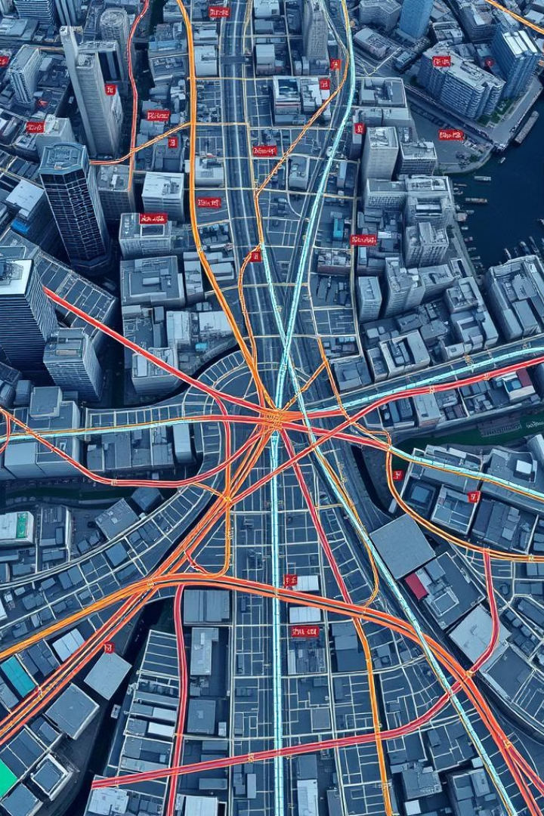
Introduction to Dynamic Route Rationalization
1
Real-Time Data
Continuously collect and analyze data from various sources to monitor changing conditions.
2
Algorithmic Optimization
Utilize advanced algorithms to identify the most efficient routes based on the available data.
3
Automated Adaptation
Dynamically update and reroute vehicles to respond to evolving circumstances.

Slide 4
Real-Time Data Integration
Traffic Monitoring
Weather Updates
Event Tracking
Aggregate data from GPS, traffic sensors, and crowd-sourced information to track vehicle movement and congestion levels.
Integrate meteorological data to anticipate and respond to weather-related disruptions, such as storms or road closures.
Monitor real-time information about construction, accidents, and other events that can impact transportation routes.

Slide 5

Optimizing for Variable Factors
Time
Cost
Minimize travel time and avoid delays to improve customer experience and operational efficiency.
Reduce fuel consumption, maintenance costs, and other expenses through more efficient route planning.
Sustainability
Safety
Consider environmental factors like emissions and carbon footprint to promote eco-friendly transportation solutions.
Prioritize routes that minimize risks and hazards, ensuring the well-being of drivers and customers.

Slide 6




Leveraging AI and Machine Learning
Predictive Analytics
Use machine learning models to forecast traffic patterns, weather conditions, and other variables that impact transportation.
Route Optimization
Employ advanced algorithms to continuously evaluate and select the most efficient routes in real-time.
Automated Decision-Making
Empower AI systems to autonomously reroute vehicles and make adjustments based on the latest data insights.

Slide 7




Customer Experience and Satisfaction
On-Time Delivery
Reliable and timely transportation ensures customer expectations are met, enhancing their overall experience.
Visibility and Transparency
Provide customers with real-time updates and tracking information to keep them informed throughout the delivery process.
Flexibility and Responsiveness
Quickly adapt to customer needs and preferences, offering alternative delivery options or rerouting as necessary.

Slide 8

Operational Efficiency and Cost Savings
Reduced Travel Time
Optimized routes and efficient rerouting can significantly decrease delivery times, improving overall productivity.
Fuel Consumption
Dynamic route planning helps minimize unnecessary mileage and idling time, leading to substantial fuel savings.
Maintenance Costs
Fewer miles driven and less wear-and-tear on vehicles can lower maintenance and repair expenses.
Labor Efficiency
Streamlined routes and reduced delivery times enable more efficient utilization of personnel and resources.

Slide 9
Case Studies and Success Stories
Retail Giant
Logistics Provider
Food Distributor
A leading e-commerce retailer achieved a 15% reduction in delivery times and a 12% decrease in fuel consumption through dynamic route optimization.
A major transportation and logistics company reported a 20% improvement in on-time deliveries and a 7% increase in operational efficiency.
A food distribution company was able to cut costs by 8% and reduce its carbon footprint by 11% through the implementation of dynamic route rationalization.

Slide 10

Conclusion and Key Takeaways
1
Adaptability
2
Efficiency and Cost Savings
Dynamic route rationalization enables organizations to respond to changing conditions and optimize transportation in real-time.
Implementing this approach can lead to reduced travel times, fuel consumption, and overall operational costs.
3
Enhancing Customer Experience
4
Competitive Advantage
Improved delivery reliability and responsiveness can significantly enhance customer satisfaction and loyalty.
Dynamic route rationalization can provide a strategic advantage by improving operational efficiency and service quality.

